Slide 1
UML (Unified Modeling Language)
Component Diagram
Deployment Diagram

Slide 2
Component diagrams
  Component diagrams provide a physical view of the current model.
  They show the organization and dependencies among software components, including source code, binary code, and executable components.
  You can create one or more component diagrams to depict components and packages or to represent the contents of each component package.

Slide 3


Component Elements
Component
  Interacting objects within system
Class/Interface/Object
Relation/Association

Slide 4
Sample Component Diagram
Component
Interface
Dependency

Slide 5
Component
Development-time or run-time physical object implementing the system.

Slide 6
Interface
A formally specified and documented boundary between two components.

Slide 7
Dependency
The components pointed to depend on the physical objects pointed from.

Slide 8
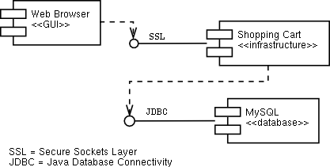
Component Diagram Example

Slide 9
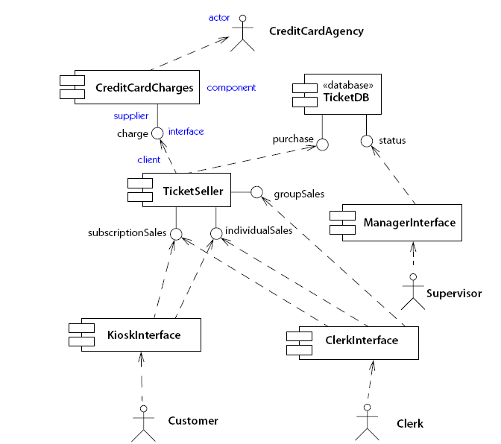
Component Diagram:

Slide 10
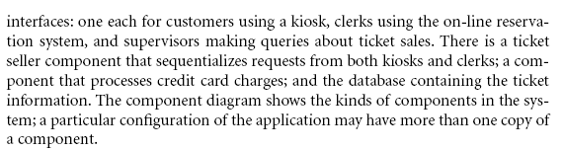
Example of component diagram:

Slide 11
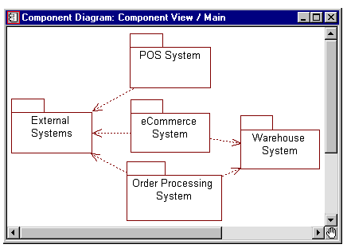
Component Diagram

Slide 12
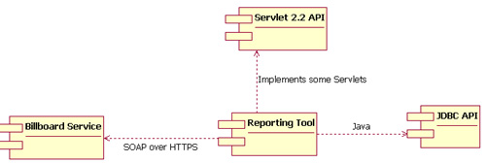
Component Diagram

Slide 13
The deployment view
The deployment view shows the mapping of processes to hardware.
Represents physical relationships among software and hardware components as realized in running system
Nodes represent computational elements (i.e. processor, server, etc.)
This type of diagram is most useful in a distributed architecture environment where you might have applications
and servers at different locations.
This view contains only one diagram – the deployment diagram.

Slide 14
Sample Deployment Diagram
Connection to some other hardware
Hardware Node
Software Component

Slide 15
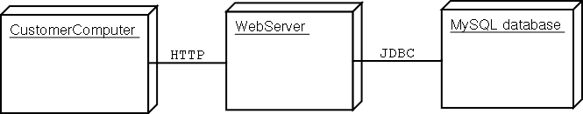
Example

Slide 16
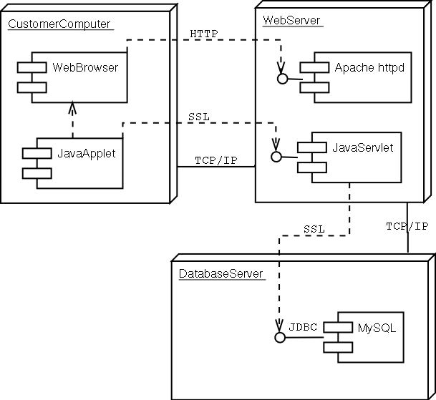
Example

Slide 17
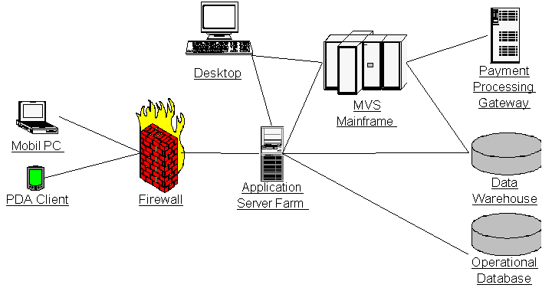
Deployment diagram

Slide 18
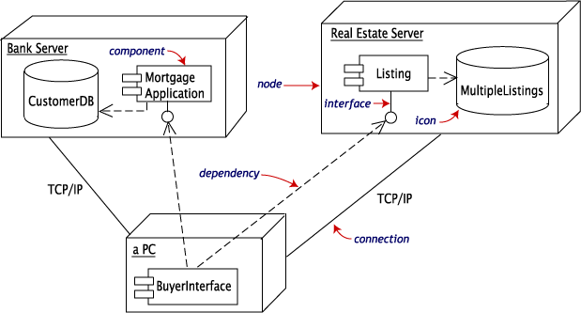
Example: Deployment diagram shows the relationships among software and hardware components involved in real estate transactions.
Components are rectangles with tabs. The database components use barrel-shaped icons.

Slide 19
Courseware Example
Construct the design elements for a system that can be used to manage courses/classes
The organization offers a courses in areas such as learning management techniques and understanding different software languages and technologies
Each course consists of a set of topics
Tutors assigned courses to teach according to their specialty and availability
Publishes and maintains calendar of courses and assigned tutors
Course Administrators who manage content, assign courses to tutors, and define schedule

Slide 20
Identify Actors
Tutors
Course Administrators
Students
Course Administrator is main actor

Slide 21
Use Case
Manage courses
  View courses
  Manage topics for a course
  Manage course information
Manage course assignments
  View course calendar
  View tutors
  Manage tutor information
  Assign courses to tutors

Slide 22
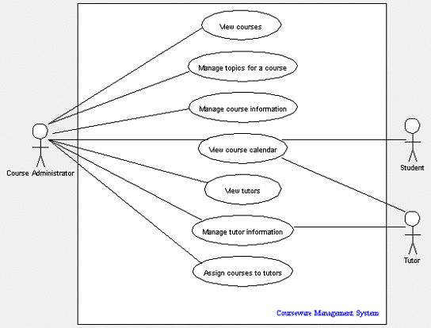
Use Case

Slide 23
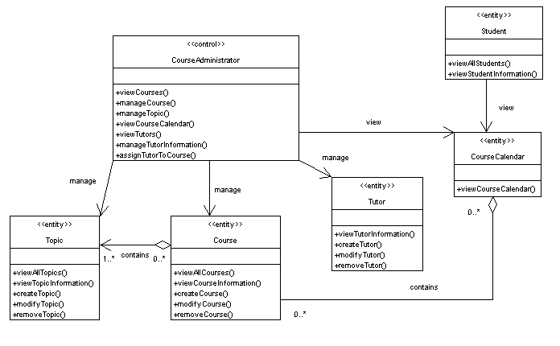
Class Diagram

Slide 24
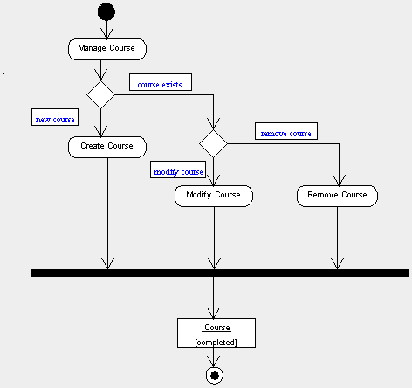
Activity Diagram

Slide 25
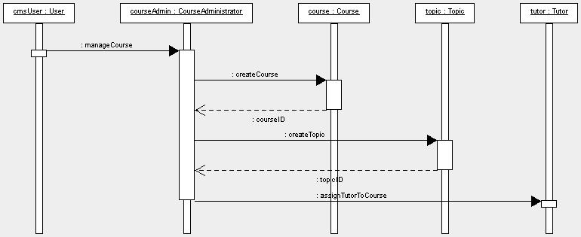
Sequence Diagram

Slide 26
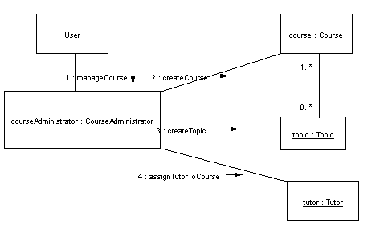
Collaboration Diagram

Slide 27
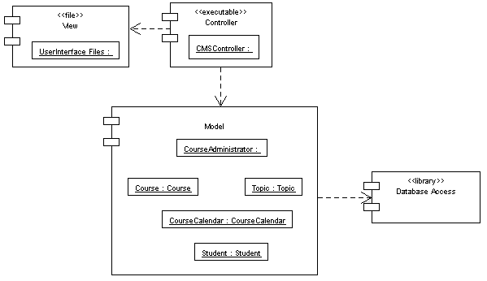
Component Diagram

